Slide 1

RISK AND RESILIENCE BOOTCAMP
6
Notes:
https://www.ncsc.gov.uk/static-assets/documents/PwnedPasswordsTop100k.txt

Slide 2


Slide 3
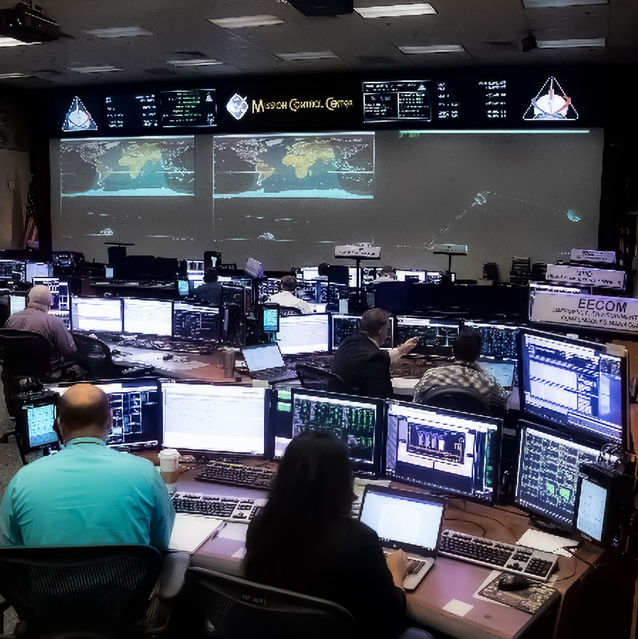
operations
This section is a more detailed look the IT operational environment from a risk perspective
Business
Technology
Data
Cyber

Slide 4
Operations
Operations is where systems, data, and users converge
Delivers the business value to end users and customers
In critical sectors, operational stability creates business resilience and customer trust
Failures in production environments can escalate quickly into
Financial loss
Regulatory exposure, and reputational damage
Operations monitoring and production support ensure that
Systems perform within expected parameters
Anomalies are detected early
Incidents are handled efficiently
Services are restored quickly and reliably
Operational resilience, as defined by DRII:
“The ability of an organization to continue to deliver its products and services at acceptable predefined levels following a disruptive incident”

Slide 5
Operations
The operational environment
Production systems are the live environments supporting business services
For example: online banking, payment gateways, trading platforms
Pre-production environments (Dev, QA, Staging) exist to test and validate before release.
Operations teams manage and monitor the production stack continuously
Often called Site Reliability Engineering (SRE) or IT Operations Center Management
Key goals of operations
Availability: keeping systems up and running 24/7
Performance: maintaining responsiveness under varying loads
Integrity: ensuring no data corruption or unauthorized change
Reliability: predictable, stable service delivery over time
Recoverability: to restore service promptly after incidents

Slide 6
Operations Technologies
The technology stacks are always evolving
New technology is always being developed
For example: Internet, more powerful processors, larger data storage capacities
New uses for technology emerge
For example: on-line banking
The historical phases of operational systems
Legacy monolith systems – usually mainframes
Distributed client-server systems often based on web technologies
Microservices, characteristic of modern systems
Cloud services which can provide an operations environment

Slide 7
Operations Technologies
All stacks have to supply common core functions
Incident management
Logging, classifying, triaging, and resolving incidents
Problem management
Analyzing root causes and recurring faults to prevent repetition
Change management
Ensuring system changes are tested, reviewed, and implemented safely
Configuration management
Maintaining a configuration management database to track and document dependencies within the Ops environment
Release management
Controlling deployment into production with rollback and verification steps

Slide 8
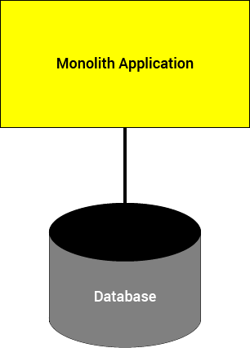
Monolith Application
Characterized by a single code base
May be modular at the programming language level
Integrated with a single database
All code uses a common schema
“Monolith” means
If a change to the code base or to the data schema
Then the entire application needs to be redeployed

Slide 9

Business Analogy
Start-up businesses are monoliths
There are a few people who do everything
The enterprise is small enough that this model works
It’s actually counterproductive to have a highly structured departmental organization with just a few employees
Early versions of applications are similar
Simple enough that all of the code is manageable
Single code base for the whole app
Flat or minimal architectural structure

Slide 10
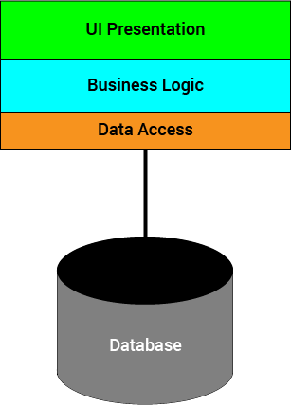
Modular Monolith
Code is modularized
Organized along job descriptions
Front end dev has their modules
Programmers have their modules
Data engineers have their modules
Shows up historically as a n-tier architecture

Slide 11

Business Analogy
As the start-up grows, it adds more people
The original organization starts to become ineffective
The entrepreneurial “all hands-on deck” model doesn’t scale well
Processes become chaotic
Difficult to manage
Productivity stalls
At some point the business must modularize
Usually by creating specialized departments
Accounting, sales, HR, etc.

Slide 12
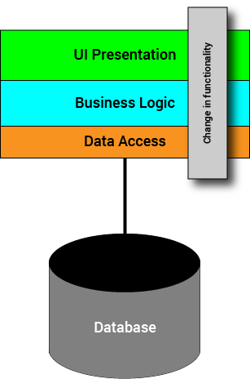
Modular Monolith
The application is still a monolith
A change in functionality
Affects each layer because related changes have to be made in each layer
Interacts with the data model
The data model may constrain what changes can be made
Changing the data model might break other parts of the app
The modules and the database often show high coupling, due to how the modules are defined

Slide 13
Pros and Cons of Monoliths
Pros
Simple to develop
Simple to test
Simple to deploy
Simple to scale horizontally
Run multiple copies behind a load balancer
Although persistence is problematic when using horizontal scaling
Cons
The size of the application can slow down the start-up time
The entire application must be redeployed on each update
Monolithic applications can also be challenging to scale vertically
Reliability issues – easy to crash the whole application
Difficult to migrate to new technologies

Slide 14
Scaling in Systems
Scaling is an increase in size or quantity along some dimension
Can take place in the development or operations space
Development scaling
Increase in complexity, functionality or volume of code
These dimensions are often related
Business analogy is a company increasing the range of services and products they offer or expanding into different markets (like a Canadian company expanding into Europe)
Operational scaling
Increase in the amount of activity of a system
Throughput, load, transaction time, simultaneous users, etc
Traditional monoliths tend to be scalable only to a limited degree
There is a certain level of complexity after which they become unmaintainable

Slide 15

Operational Complexity
Modern applications have to deal with
Petabytes of streaming data
Billions of transactions
Mission critical fault tolerance
Non-functional requirements
Throughput, response time, loading, stress
Disaster recovery, transaction time
Results in a “death star” architecture
Image: Amazon in 2008
The complexity of the operational architecture is now industrial strength

Slide 16

IT Failures and Complexity
The United States is losing almost as much money per year to IT failure as it did to the [2008] financial meltdown. However the financial meltdown was presumably a one­time affair. The cost of IT failure is paid year after year, with no end in sight. These numbers are bad enough, but the news gets worse. According to the 2009 US Budget [02], the failure rate is increasing at the rate of around 15% per year.
Is there a primary cause of these IT failures? If so, what is it?.... The almost certain culprit is complexity.... Complexity seems to track nicely to system failure.
Once we understand how complex some of our systems are, we understand why they have such high failure rates.
We are not good at designing highly complex systems. That is the bad news. But we are very good at architecting simple systems. So all we need is a process for making the systems simple in the first place.
Roger Sessions

Slide 17
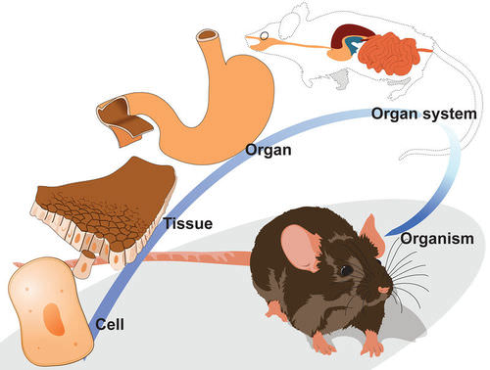
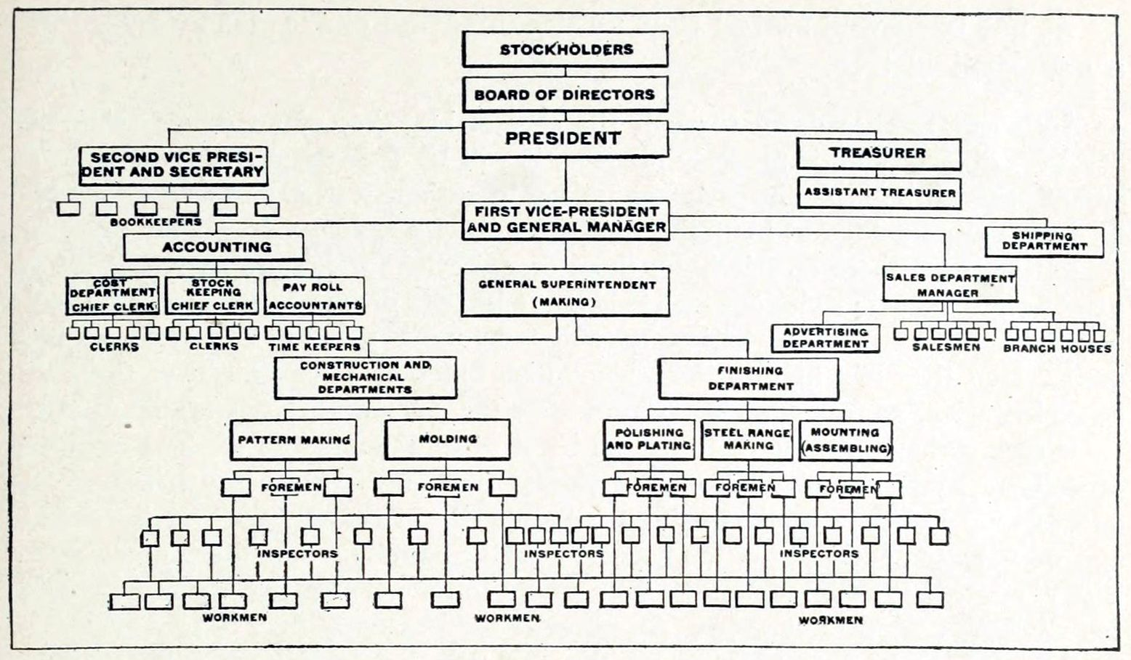
Natural Systems Organization
Naturally occurring systems scale successfully
Biological processes, social organization etc.
They all show similarities in organization regardless of domain
Natural occurring systems tend to be
Recursive in structure
Hierarchical or layered
Modular at each layer
Loosely coupled and highly cohesive

Slide 18

Operational Complexity in Practice
In production, systems have to scale operationally
Consider a diner
During the lunch and dinner hour rush, the number of servers and cooks have to scale up
There has to be clear boundaries on what each role does
During non-peak hours, the amount of staff can be scaled down

Slide 19
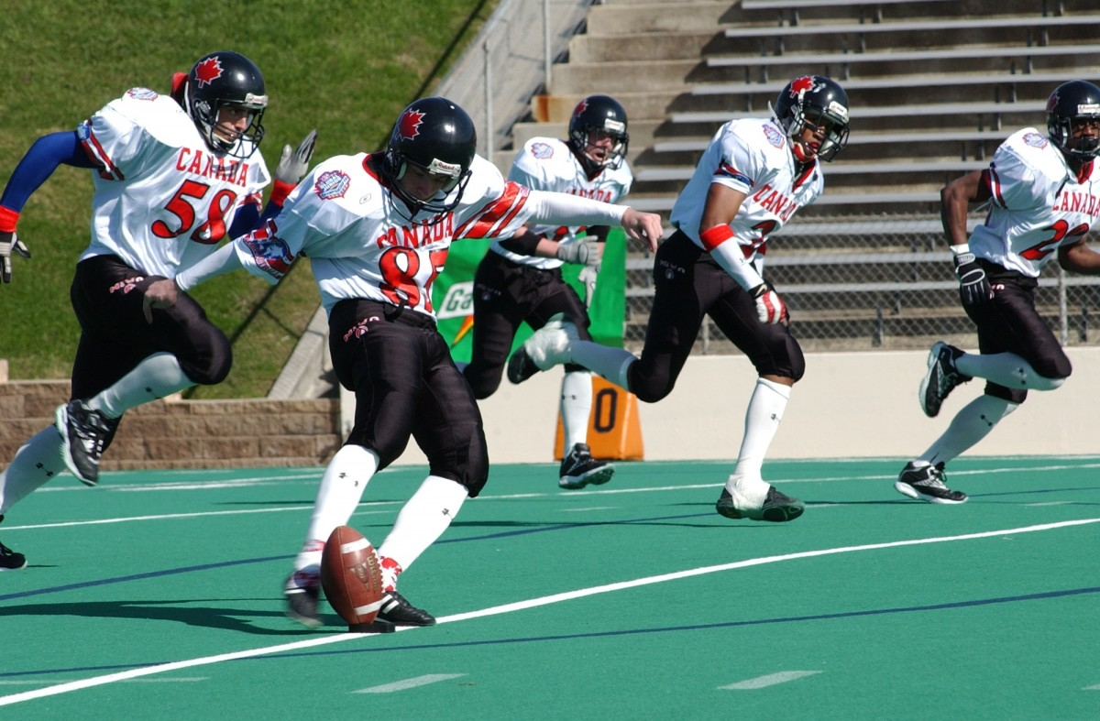
Operational Complexity in Practice
Operations are specialized
Tasks are broken down into sub-tasks, and sub-tasks broken down into sub-sub-tasks, and so on
At some point
Specialized systems or agents perform an individual sub-task
These are all coordinated
For example, the specialized positions on a sports team

Slide 20
Complex Systems
Frequently, complexity takes the form of a hierarchy, whereby a complex system is composed of interrelated subsystems that have in turn their own subsystems, and so on, until some lowest level of elementary components is reached
Courtois
On Time and Space Decomposition of Complex Structures Communications of the ACM, 1985, 28(6)

Slide 21
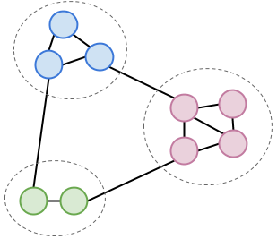
Complex Systems
Intra-component linkages are generally stronger than inter-component linkages. This fact has the effect of separating the high frequency dynamics of the components – involving the the internal structure of the components – from the low frequency dynamics – involving the interaction among components
Simeon

Slide 22
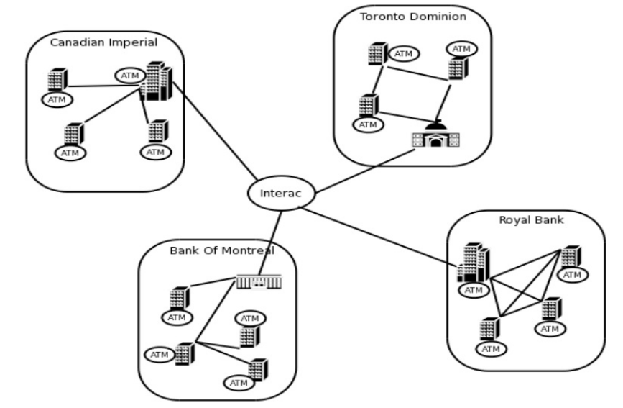
Complex Systems
Hierarchical systems are usually composed of only a few different kinds of sub-systems in various combinations and arrangements
Simeon
A complex system that works is invariably found to have evolved from a simple system that worked. A complex system designed from scratch never works and can never be patched up to make it work. You have to start over, beginning with a simple working system.
John Gall
Systemantics: How Systems Really Work and How They Fail 1975

Slide 23

Microservices
“The Microservice architectural style is an approach to developing a single application as a suite of small services, each running in its own process and communicating with lightweight mechanisms, often an HTTP resource API.”

Slide 24
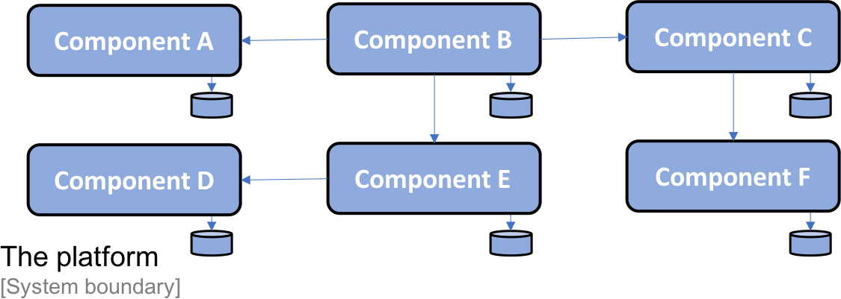
Microservices

Slide 25
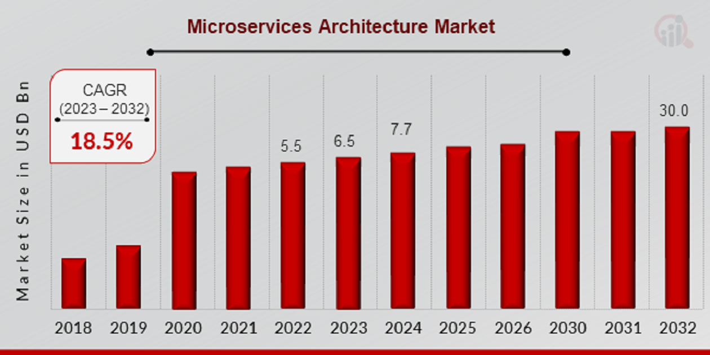
Microservices

Slide 26
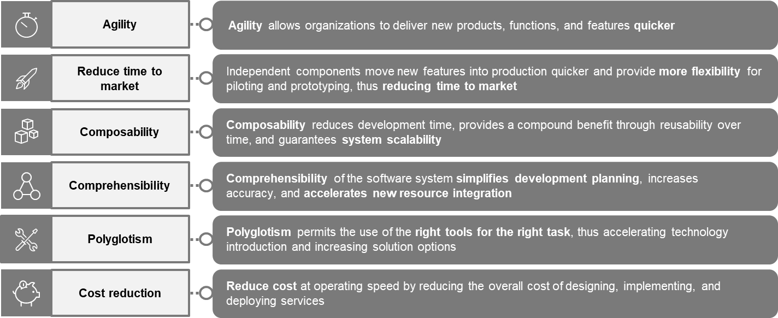
Microservices Drivers

Slide 27
Microservices Core Concepts
Microservices are small, independent, composable services
Each service can be accessed by way of a well-known API format
Like REST, GraphQL, gRPC or in response to some event notifications
Breaks large business processes into basic cohesive components
These basic process actions are implemented as microservices
The business process is executed by making calls to these microservices
Each microservice provides one cohesive service
Microservices do not exist in isolation
They are part of a larger organization framework

Slide 28
Microservices Core Concepts
Microservices
Coordinate with other microservices to accomplish the tasks normally handled by a monolithic application
Communicate with each other synchronously or asynchronously
Make application components easier to develop and maintain
Are a lot harder and more complicated to manage when deployed

Slide 29
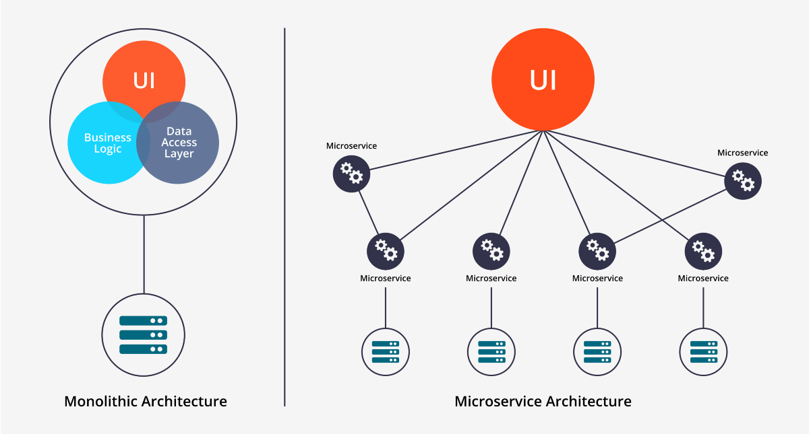
Monolith to Microservice

Slide 30
Microservice Deployments
Light-weight, independent, and loosely-coupled
Each has its own codebase
Responsible for a single unit of business functionality
Uses the best technology stack for its use cases
Has its own DevOps plan for test, release, deploy, scale, integrate, and maintain independent of other services
Deployed in a self-contained environment
Communicates with other services by using well-defined APIs and simple protocols like REST over HTTP
Responsible for persisting its own data and keeping external state

Slide 31
Business Drivers
Business Agility
Speed of change is faster with a more modular architecture
React quicker to feature and enhancement requirements
Easy integration with new technology, processes (Mobile, Cloud, Continuous DevOps)
Composability
Allows for reuse of capability and functionality
Allows for integration with other internal and external services
Reduces technical debt and replication
Robustness and Migration
A single microservice failure does not bring down an application
The business functionality is always available
Updated functionality can be rolled out in a controlled and safe manner
Smaller components reduces risk exposure

Slide 32
Business Drivers
Scalability
Services can scale up to handle peak loads, or down to save costs
Enable Polyglot Development
Different technologies can be used for different services
No lock-in to a single technology across the whole business

Slide 33
Pros and Cons of Microservices
Pros
Easy to develop individually
Easy to understand individually
Easy to deploy individually
Easy to monitor each service
Flexible Release Schedule
Use standard APIs (JSON, XML)
Cons
Requires retooling
Requires more deployments
Requires translation (JSON, XML)
Requires more monitoring
Operations configuration can be very complex
System can be very complex

Slide 34
Types of Microservices
Primary distinction: Request versus Event based
Request based
A request is made of a service from a specific client
Some sort of response is expected by the client
Event based
The service is responding to a series of events that are occurring somewhere
Events don’t expect a response
These are often referred to as synchronous versus asynchronous
Not quite accurate

Slide 35
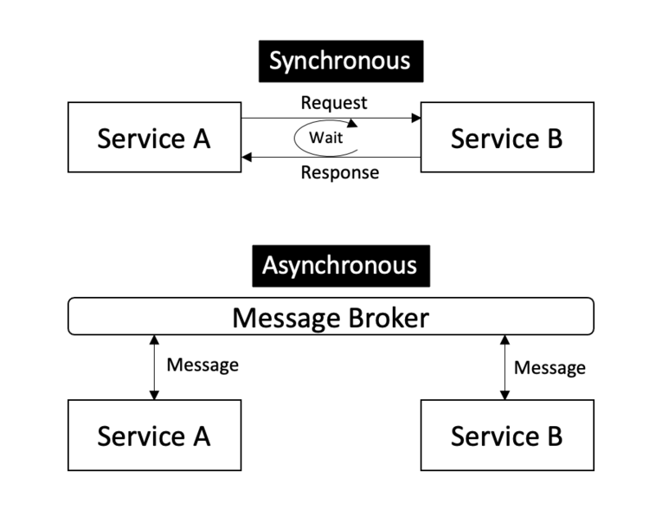
Basic Architectural Approaches

Slide 36
Request Based Microservice
Generally part of a logic flow
Implementation of some sort of scenario or process
For example: Online purchase
There is a clear workflow
User logs in and is taken to home screen
User searches for item and selects item
User places order
Payment is approved
Request for shipment is generated and sent to fulfillment
Each step may be handled by a different microservice
Account services, payment service, catalog service, etc.

Slide 37
Request Based Microservice
Often referred to as a synchronous service
Each request requires a reply
The service may “block” waiting for a reply
This is a common use of the term synchronous
However, request based microservices may be asynchronous
Often referred to as “fire and forget”
The sending application process can continue while waiting for a reply
In the sales example
The request for shipment can be made
But the sale interaction ends without getting a confirmation of the shipment details
The confirmation can be sent later (maybe email) once the order is processed

Slide 38
A Subtle Distinction
What do we mean by a reply?
It could mean that we have the answer to our request
“Your payment has been successfully processed, here is your receipt”
“You have been authenticated to the system, access token enclosed”
Or we just have the receipt of our request acknowledged
“Your order has been received, you will receive a confirmation email later”
“Your request has been received and you will receive a ticket number once it has been entered into the system”
Request based microservices
Can be synchronous or asynchronous
But tend to be the better option when dealing with synchronous types of processing

Slide 39
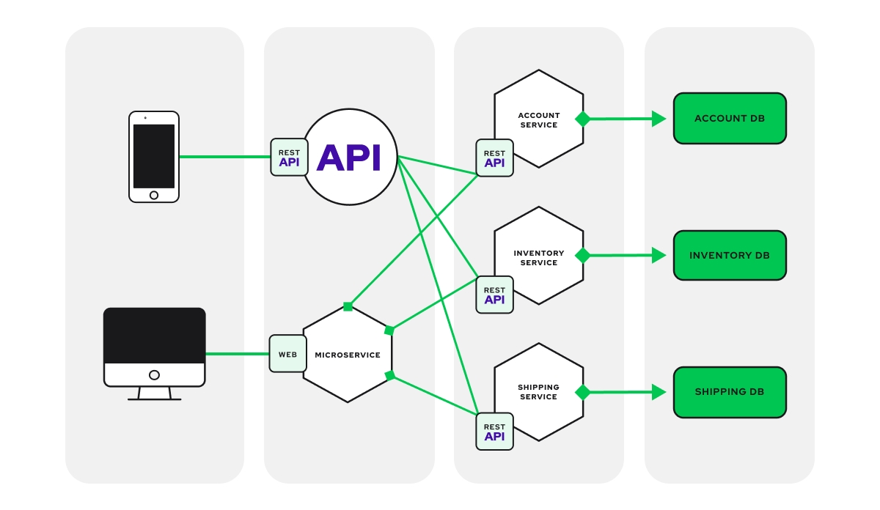
Request Based

Slide 40
Processing a Request
Request arrives at an endpoint
Depending on the service requested
The message is routed to an internal service that handles that type of request
That service routes the message to a running process to handle the process
The process retrieves any state data it needs from the data service
Request is processed
State data store is updated
Response returned to service that returns to the endpoint that received the request
More than one process type may be involve
Processes are stateless and horizontally scale-able
The main challenge: how do you orchestrate the flow of messages?

Slide 41
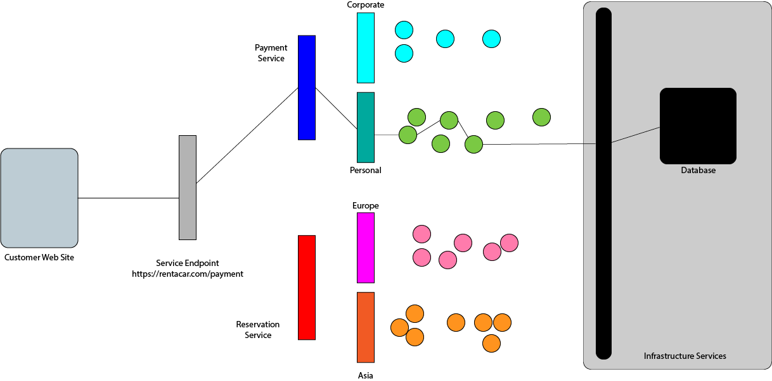
Processing a Request

Slide 42
The Operations Challenge
Processes are usually deployed in Docker or similar containers
But we have to solve:
Coordinating the activity of possibly thousands of containers that need to work together
Creating and maintaining connections between containers
Ensure the whole system operates well enough to meet Service Level Agreements (SLAs)
We need to deal with non-functional requirements
Loading, throughput, stress, response times
Disaster recovery
Security
The lack of an effective way to do this was a major historical impediment to the deployment of microservice based applications

Slide 43

Kubernetes
Kubernetes is a container orchestration manager
Not the only manager
Docker Swarm does the same
Kubernetes is “industrial strength”
Orchestration:
Manages “clusters” of containers
Provides service discovery
Manages scaling and failover
Works at the Ops level
Infrastructure as Code

Slide 44
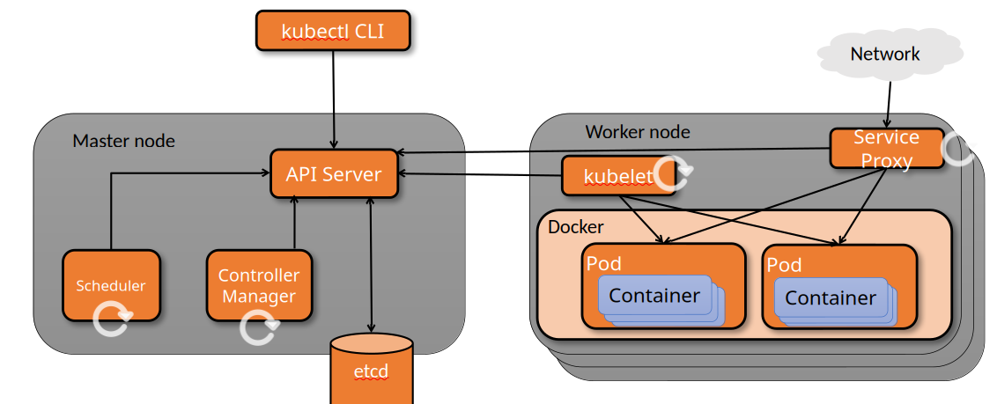
Kubernetes Architecture
Kubernetes nodes can be physical hosts or VM’s running a container-friendly Linux

Slide 45
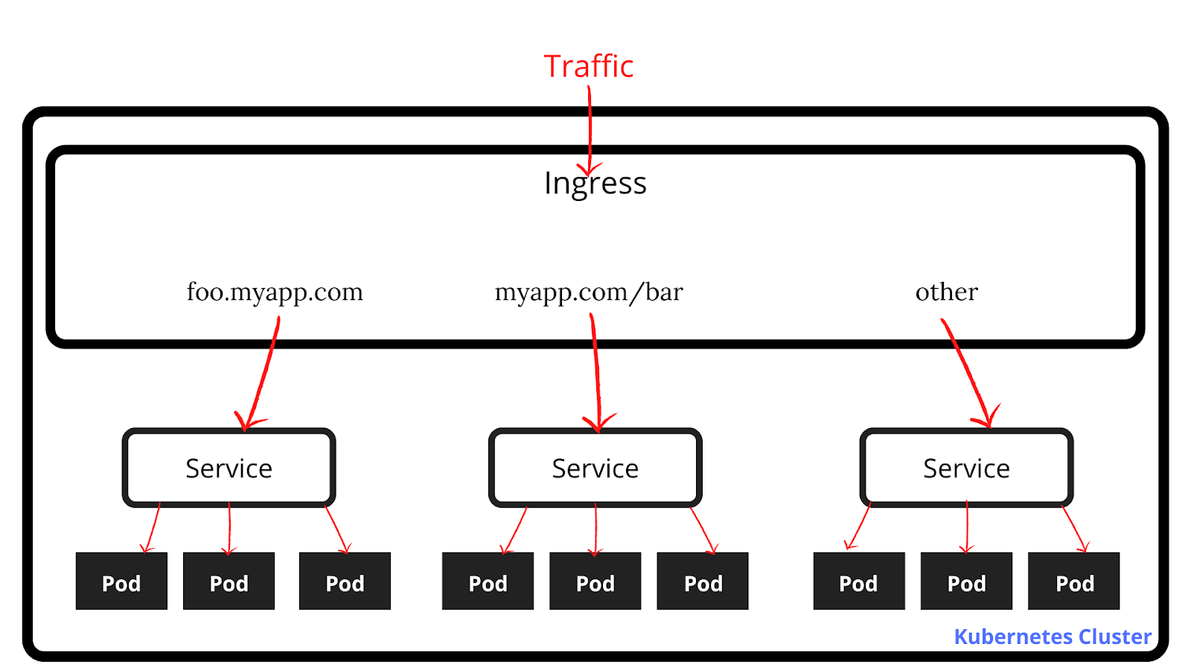
Kubernetes Services

Slide 46
Common Deployment
Modern microservices that are request based tend to use a common set of tools
Containers
Small, self contained units of functionality
Designed to follow all the good design principles: cohesive, supple, etc
Dynamically horizontally scalable
Pods
Wrapper around a container or set of containers to create a usable microservice
Adds the necessary interface and infrastructure so the containers can be managed by the orchestration tool
Orchestration
A control system that manages the pods and running environment
Routes incoming requests to the appropriate microservice

Slide 47
Event Based Microservice
Responds to a stream of events
Asynchronous in design
Events may require a response by the system
But response may or may not involve a reply to the event source
The response is often an event sent to another service
Architectural implementation of the Command and Chain of Responsibility design patterns
Example: Heat sensor
A heat sensor in a power plant takes a heat reading
An event is sent to the monitoring microservice
Monitoring service creates new events in response
Sends an event to the data recording service to log the data
If the reading is anomalous, it sends an event to an alert services

Slide 48
Event Based Microservice
Events may require a response by the system
But response may or may not involve a reply to the event source
The response is often an event sent to another services
Typical use cases
Event Response
Events might occur that require a response that is not a reply to the event source
For example: monitoring heat sensors in a nuclear reactor
The response is a reaction by the system to the event, not a reply to the sensor
Event Streaming
Events are just collected and processed for later use
For example: collecting GPS location of cell phones
Collecting point of sales data for data analytics
No reply or response required

Slide 49
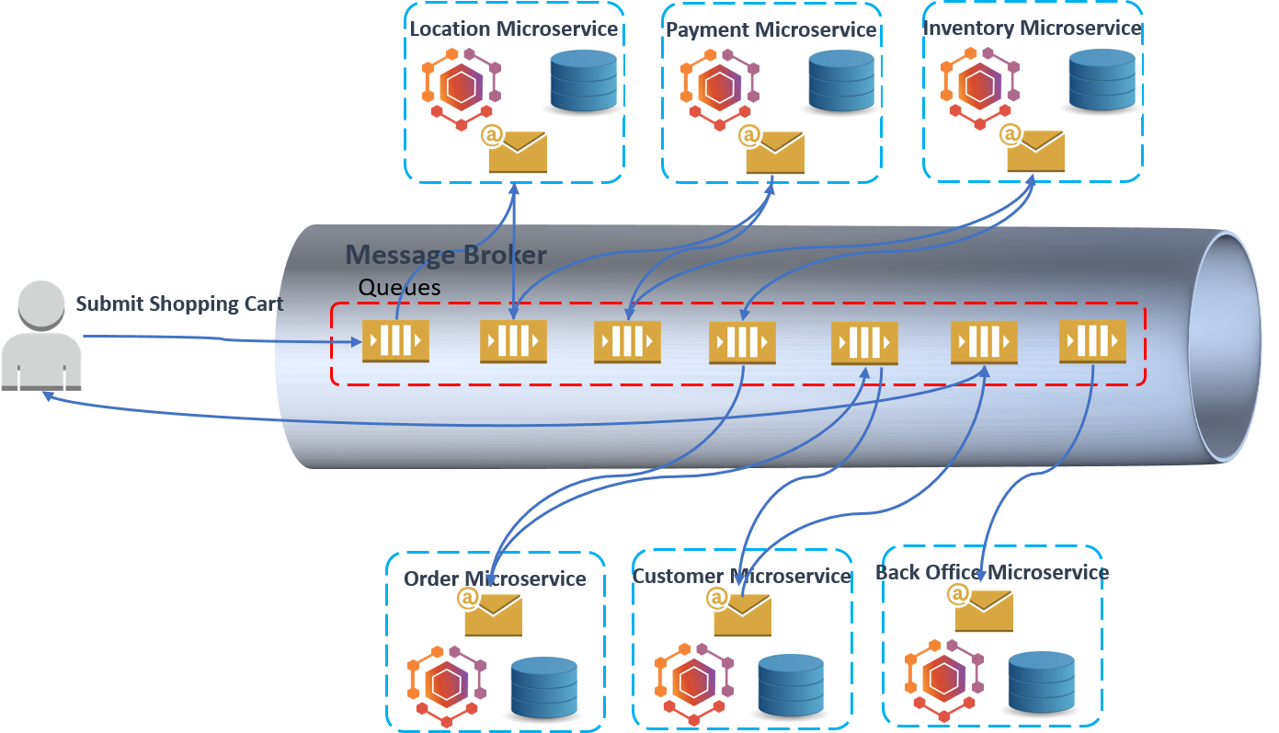
Event Based Microservice

Slide 50
Event Based Microservice
Instead of messages, we think in terms of events
An event is some data item of interest in the domain
Instead of a cluster like Kubernetes, the main artifact is a stream or queue
Publishers put events onto the queue
Subscribers get events off of the queue
Generally referred to as the “pub-sub” model
The most common technology used is Kafka
Acts as a asynchronous buffer between publishers and subscribers

Slide 51
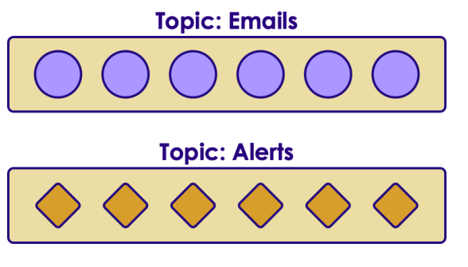
Kafka Concepts
In Kafka a basic unit of data is a 'message'
Message can be email / connection request / alert event
Messages are stored in 'topics'
Topics are like 'queues'
Sample topics could be: emails / alerts

Slide 52
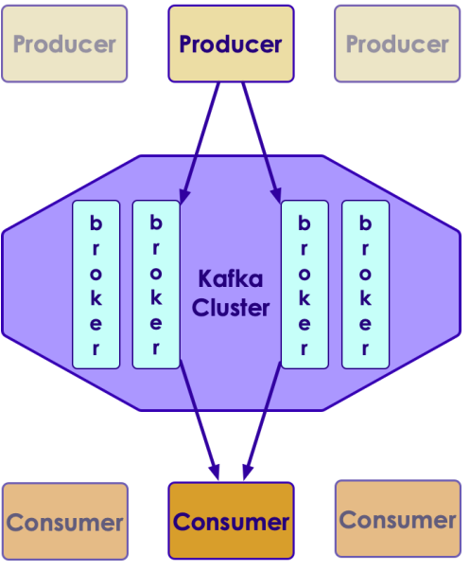
Kafka Architecture

Slide 53
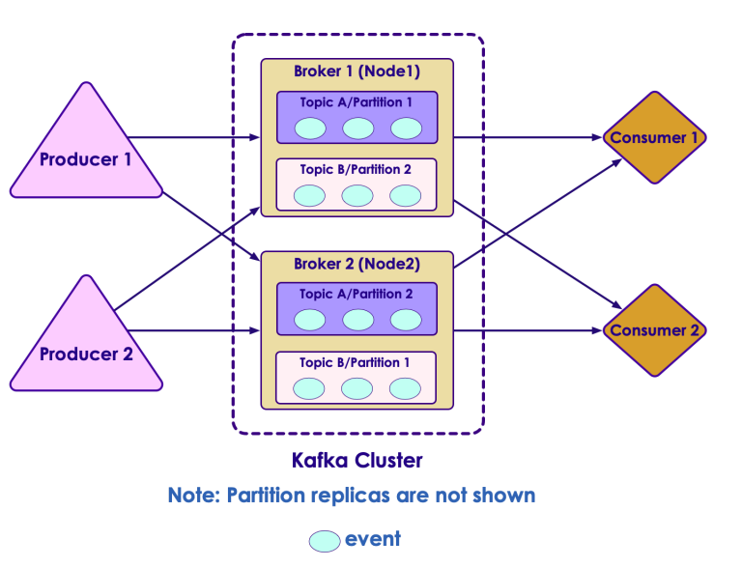
Kafka Architecture

Slide 54
Hybrid Microservice
Often, microservice architecture is hybrid
Parts of the service are request based
Parts of the service are event based
Coupling
Message based are more tightly coupled ecause they require the message be sent to an endpoint
Event based are more loosely coupled because requests are buffered in a queue

Slide 55
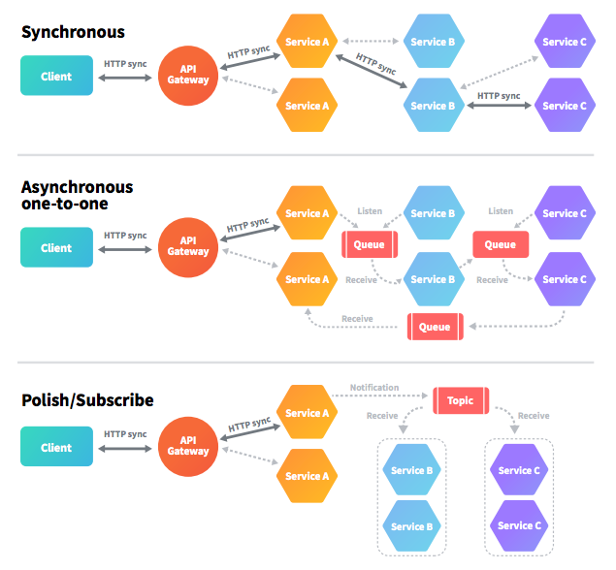
Kafka Architecture

Slide 56
Transactional State
Does an incoming message require a synchronous response?
Does the incoming message represent a request or an event?
Requests usually kick off a business process or use case
Events just happen “out there” and can be dealt with in isolation
Events tend to stream from event sources, requests originate from clients
Do we need to maintain state?
Business processes often require tracking transactional state
Events are usually stateless
What sort of scaling requirements do we have?
How we manage transactional state may depend on our scaling requirements

Slide 57
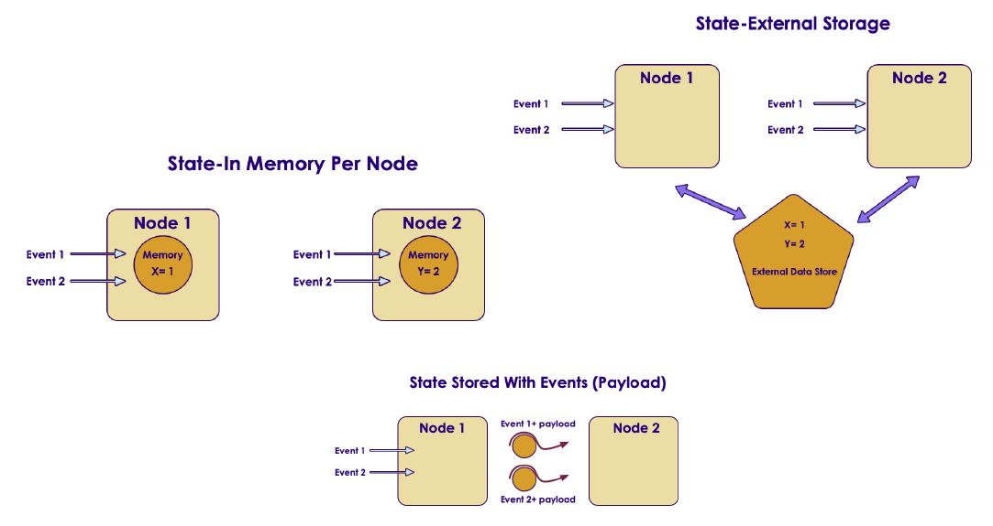
State Representation

Slide 58
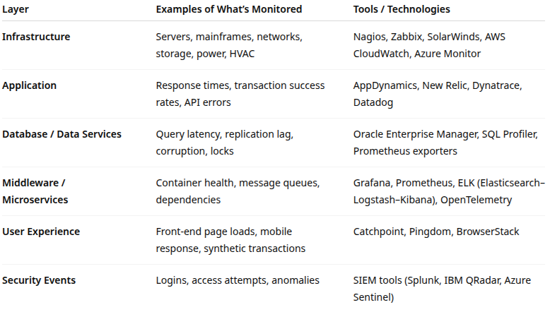
Operations Monitoring
Monitoring is both proactive (detect early) and reactive (respond fast)
It spans multiple layers of the IT architecture

Slide 59
Operations Monitoring
Modern production support environments rely on
NOC (Network Operations Center): focuses on network health and uptime
SOC (Security Operations Center): monitors and responds to security threats
SRE (Site Reliability Engineering): automates reliability through IaC and observability
Ops Command Centers: integrated cross-domain response for high-impact incidents
Monitoring is effective when it is
Integrated: unified dashboards across systems
Contextual: aligned with business processes and risk criticality
Actionable: alerts correlate to meaningful incidents, not noise

Slide 60
Operations Monitoring Tools
Legacy operations (mainframes and monoliths)
Typically centralized systems with batch processes and predictable workloads
Monitoring focuses on job completion, I/O throughput, and storage utilization
Distributed and web-based operations
Multi-tier architectures (web, app, DB)
Use of middleware, load balancers, and APIs
Emphasis on end-to-end monitoring and dependency mapping

Slide 61
Operations Monitoring Tools
Cloud and hybrid monitoring
Cloud-native services (AWS, Azure, GCP) provide integrated metrics, logging, and alerting
Hybrid architectures require federation of monitoring tools from the different operations environments
Use of AIOps (AI for IT Operations) to detect anomalies and predict outages
Machine learning is used to do effective anomaly detection and deviations from baselines
Does not replace human oversight and decision making
Helps manage the massive amounts of data collection
Helps filter out events that might be missed otherwise

Slide 62
Operations Monitoring Tools
DevOps and CICD
Monitoring embedded in the pipeline
Automated tests, deployment health checks, rollback automation
“Shift-left monitoring” goal is catching operational risks earlier in the lifecycle

Slide 63
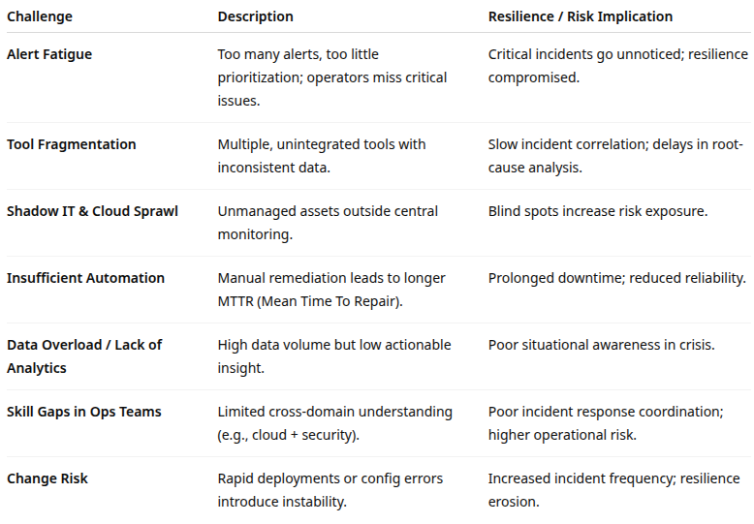
Common Challenges in Operations

Slide 64
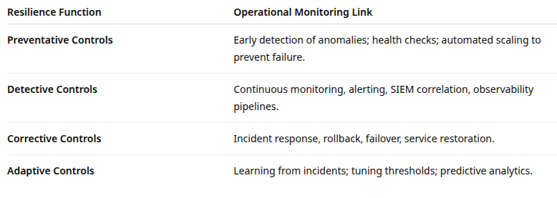
Risk and Resilience

Slide 65
Best Practices
Define critical services and dependencies
Identify systems supporting mission-critical processes (e.g., payments, authentication)
Prioritize monitoring coverage accordingly
Integrate security and operations monitoring
Correlate performance metrics with security events for unified situational awareness
Implement observability architecture
Combine metrics, logs, and traces into a unified big picture

Slide 66
Best Practices
Use predictive analytics and AIOps
Detect anomalies before they become incidents
Automate triage and escalation
Embed resilience metrics
Track MTBF, MTTR, SLA breaches, and incident trends
Link them to risk appetite and tolerance thresholds
Conduct regular drills and war-games
Use real monitoring data to simulate outage and recovery scenarios
Assess monitoring effectiveness and operator readiness

Slide 67
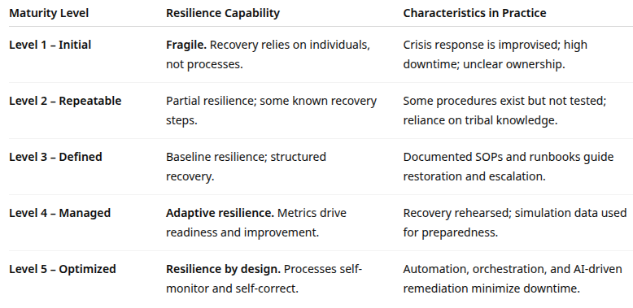
Process Maturity

Slide 68

Q&A and open discussion
Notes:
Now is the time to engage in an interactive Q&A session where you can ask questions, share insights, and clarify any doubts about the topics we have covered so far.
This open discussion is designed to ensure that every participant has the opportunity to voice their thoughts and learn from the collective experience of the group.
Your questions and comments are valuable as they help us identify areas that may need further explanation and enable us to tailor future sessions to your needs.
We encourage you to speak up and contribute to the dialogue, as this interaction is one of the key components of our interactive learning approach.
As the session progresses, take note of any questions or ideas that you would like to revisit, and feel free to share your perspectives with the class.

